Slide 1
Computer Security Lecture 1

Slide 2
Introduction to Computer Security:
• Computer security, also known as cybersecurity or IT security, is the protection of information systems from theft or damage to the hardware, the software, and to the information on them, as well as from disruption or misdirection of the services they provide.
• Computer security is needed to protect the computing system and to protect the data that they store and access.
Transmission of data using network (Internet) and communication links has necessitated the need to protect the data during transmission over the network.
• Computer security focuses on the security attacks, security mechanisms and security services

Slide 3
Security attacks are the reasons for breach of security.
Security attacks comprise of all actions that breaches the computer security.
• Security mechanisms are the tools that include the algorithms, protocols or devices, that are designed to detect, prevent, or recover from a security attack.
• Security services are the services that are provided by a system for a specific kind of protection to the system resources.
• The purpose of computer security is to provide reliable security services in the environments suffering security attacks, by using security mechanisms. The security services use one or more security mechanism(s).

Slide 4
Security Threat and Security Attack:
• A threat is a potential violation of security and causes harm. A threat can be a malicious program, a natural disaster or a thief.
• Vulnerability is a weakness of system that is left unprotected. Systems that are vulnerable are exposed to threats.
• Threat is a possible danger that might exploit vulnerability; the actions that cause it to occur are the security attacks.
• For example, if we leave the house lock open—it is vulnerable to theft; an intruder in our locality (might exploit the open lock) is a security threat; the intruder comes to know of the open lock and gets inside the house—This is a security attack

Slide 5
A security attack may be a passive attack or an active attack.
• The aim of a passive attack is to get information from the system but it does not affect the system resources.
Passive attacks may analyze the traffic to find the nature of communication that is taking place, or, release the contents of the message to a person other than the intended receiver of the message.
Passive attacks are difficult to detect because they do not involve any alteration of the data. Thus, the emphasis in dealing with passive attacks is on prevention rather than detection.

Slide 6
An active attack tries to alter the system resources or affect its operations. Active attack may modify the data or create a false data.
An active attack may be a masquerade (an entity pretends to be someone else), replay (capture events and replay them), modification of messages, and denial of service. Active attacks are difficult to prevent.
• Security attacks can be on users, computer hardware and computer software.
• Attacks on users could be to the identity of user and to the privacy of user.
Attacks on the privacy of user involve tracking of user’s habits and actions—the website user visits, the buying habit

Slide 7
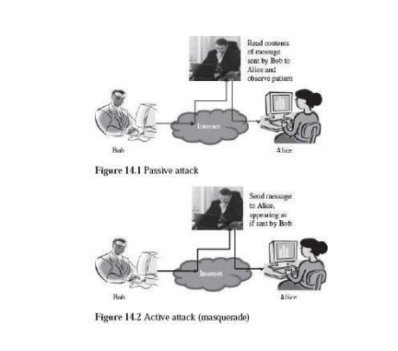
Attacks on computer hardware could be due to a natural calamity like floods or earthquakes; due to power related problems like power fluctuations etc.; or by destructive actions of a burglar.

